Slide 1
Our long... Long way..
Alena Jurcsíková Michaela Šimkovičová II.E

Slide 2
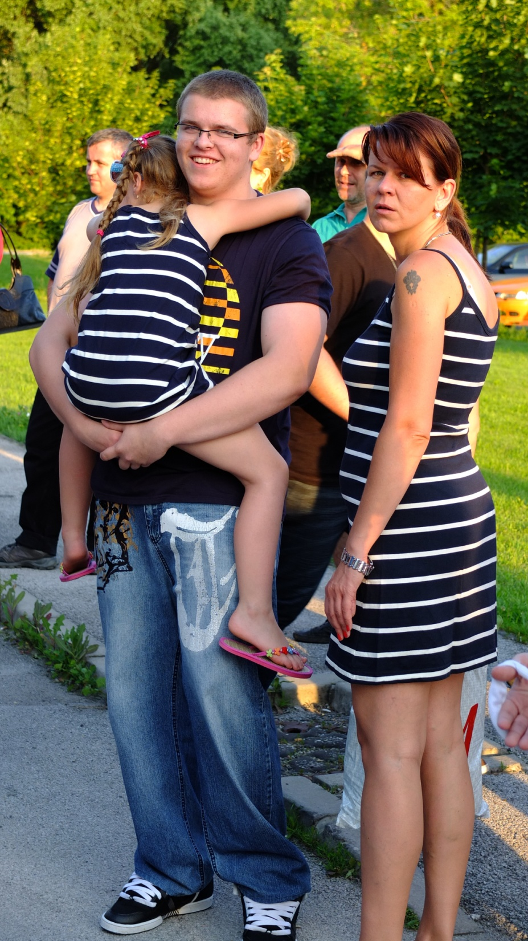
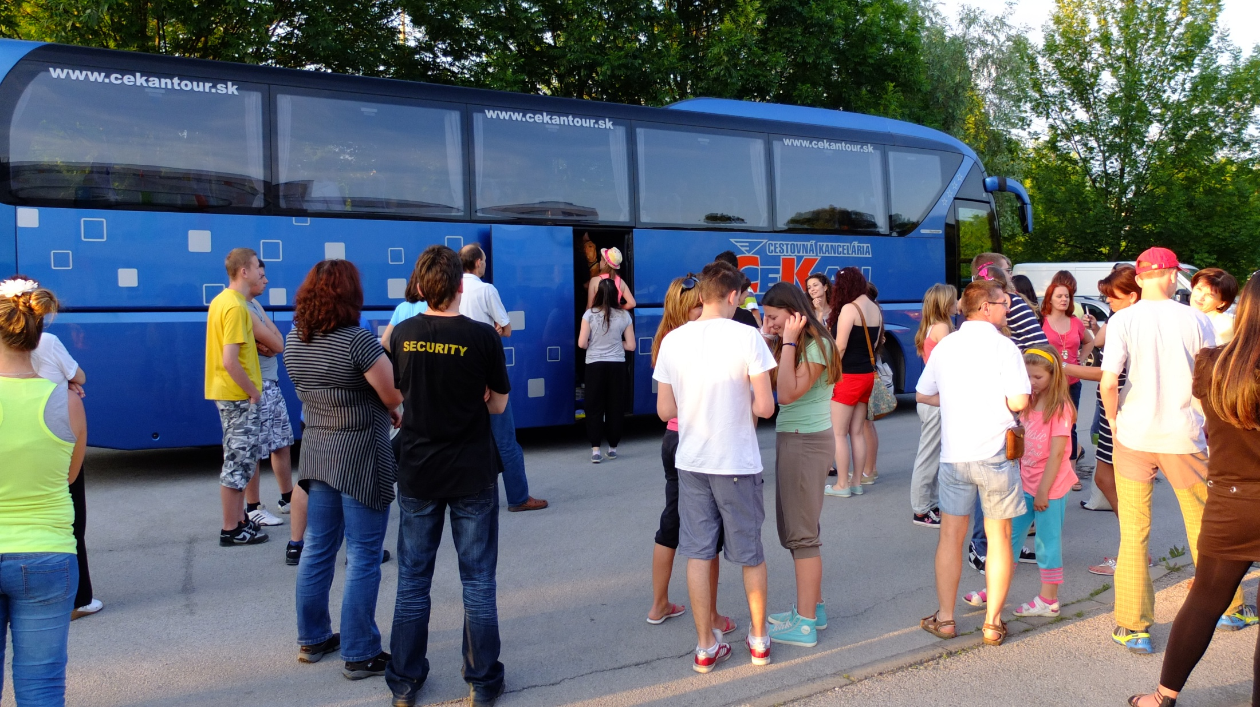
Journey to Spain
Slovakia
Austria
Italy
France
Spain

Slide 3
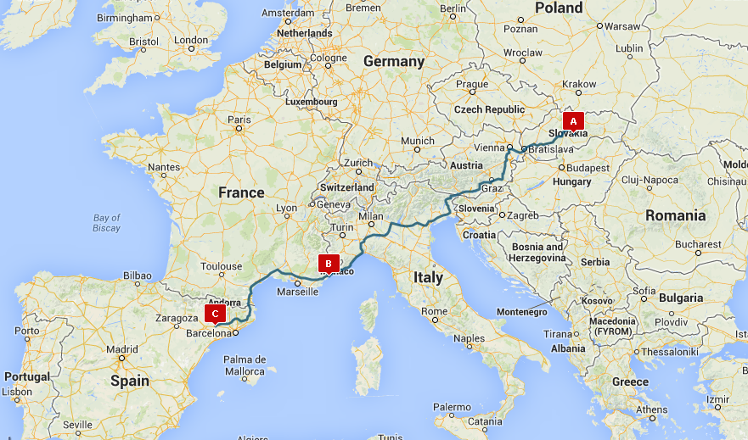

Slide 4
Everybody has their own way to.. kill the time

Slide 5
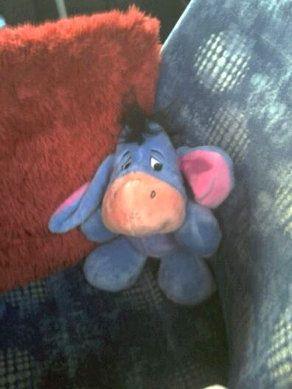
Someone wants to take photos of... Their friends

Slide 6
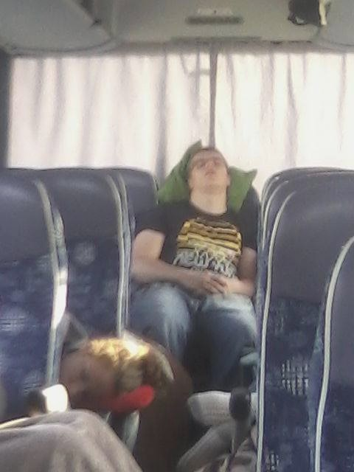
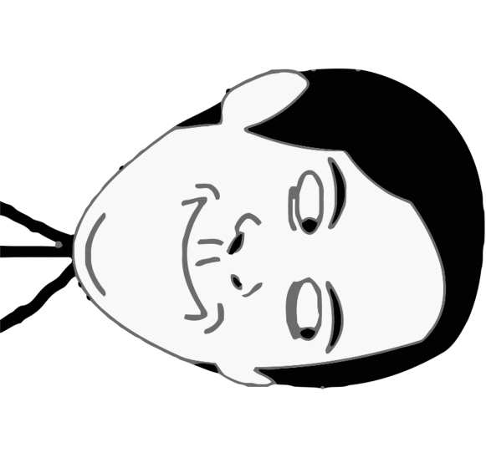
Someone is just too... sleepy

Slide 7
And so on You know that Playing games, talking.. In fact everything that makes your way somehow shorter ...Or maybe staring out of the window...

Slide 8
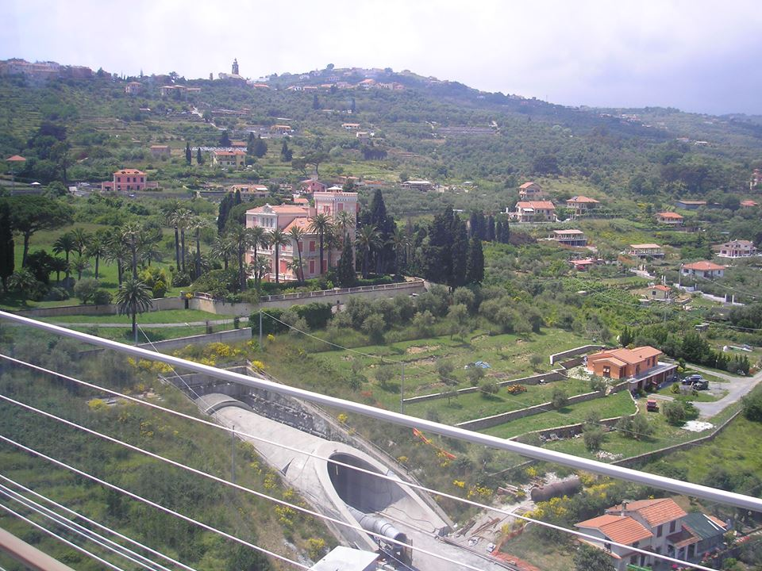
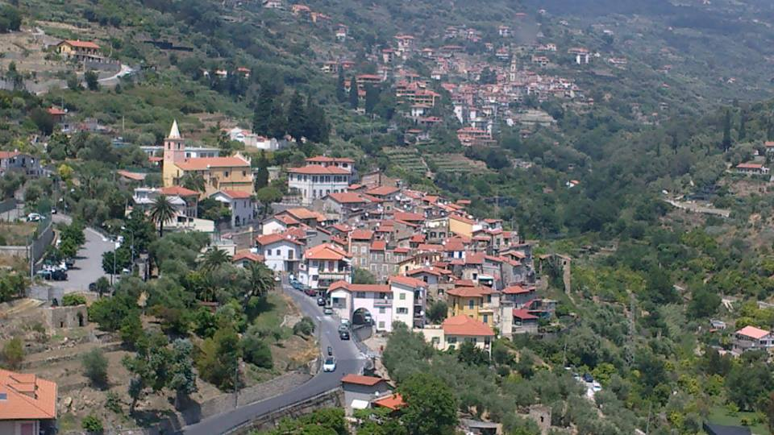

Slide 9
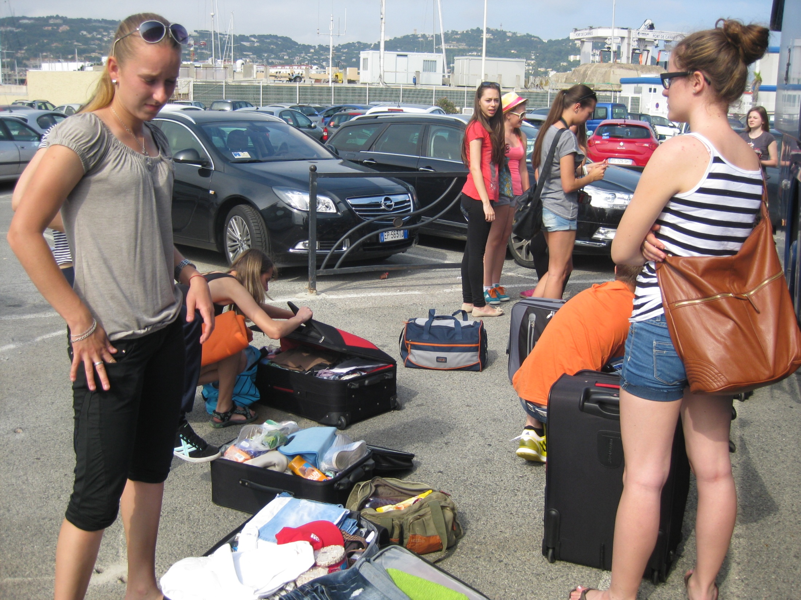
Our first stop is Cannes, France! There, everybody has their own way to kill those 9 hours, too

Slide 10
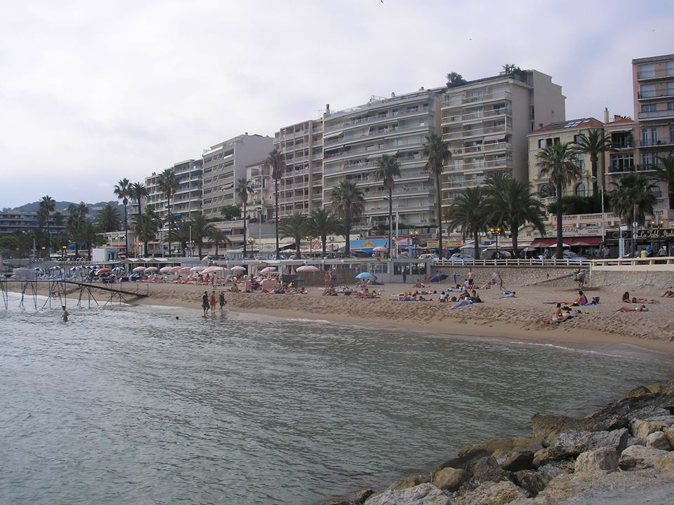
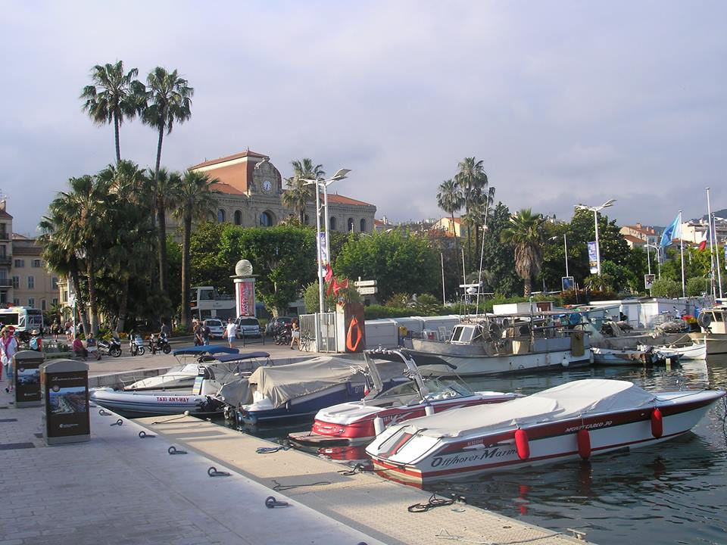
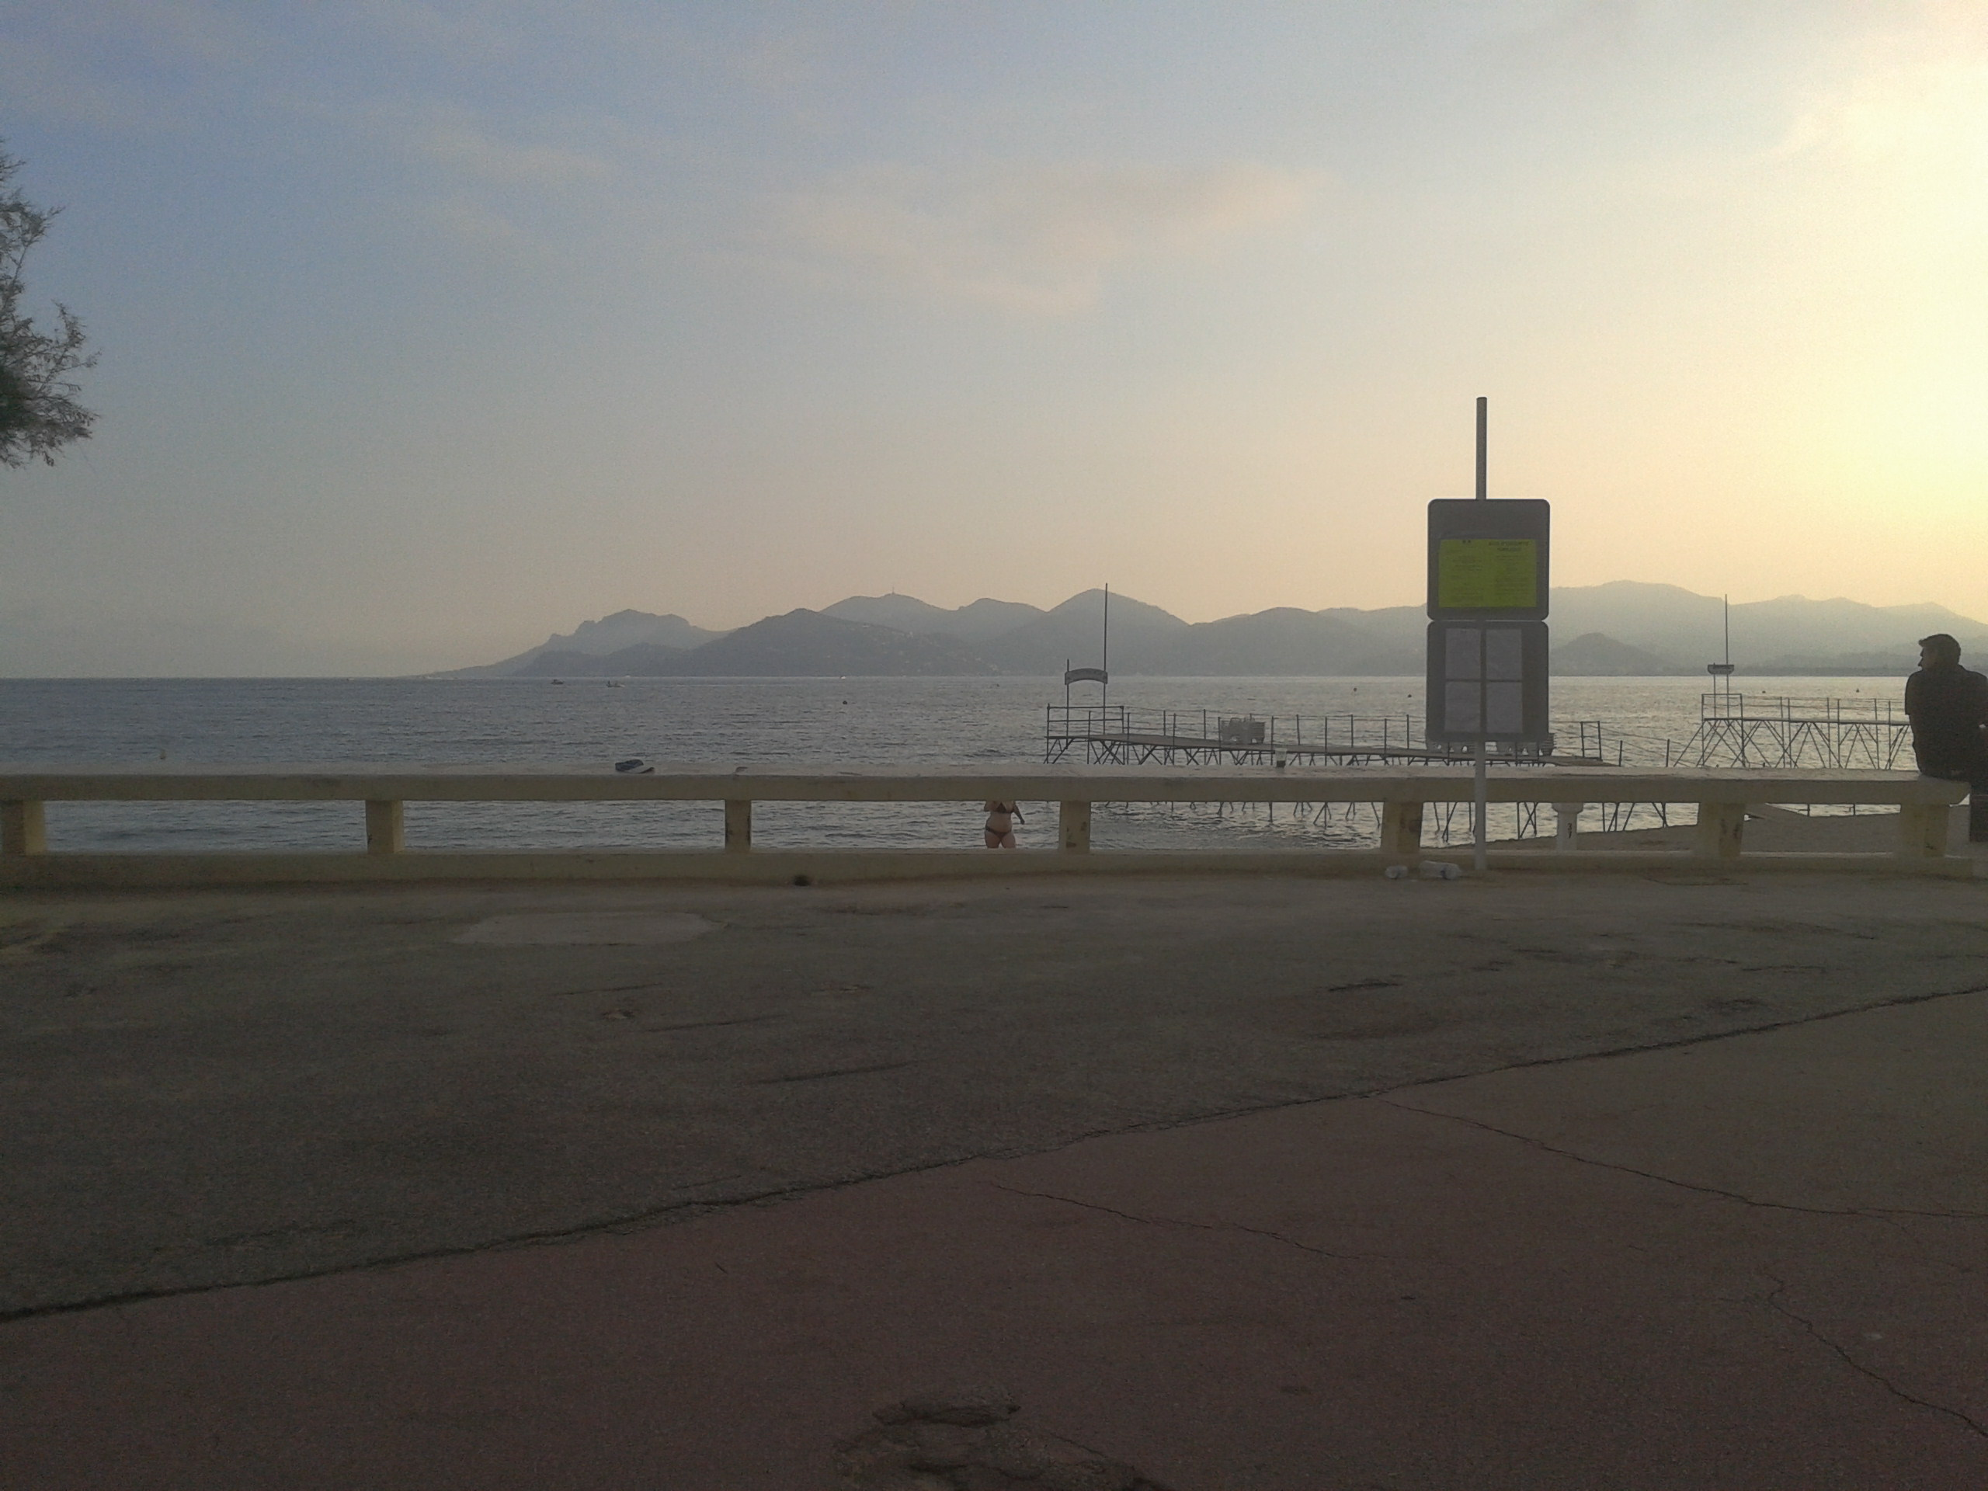
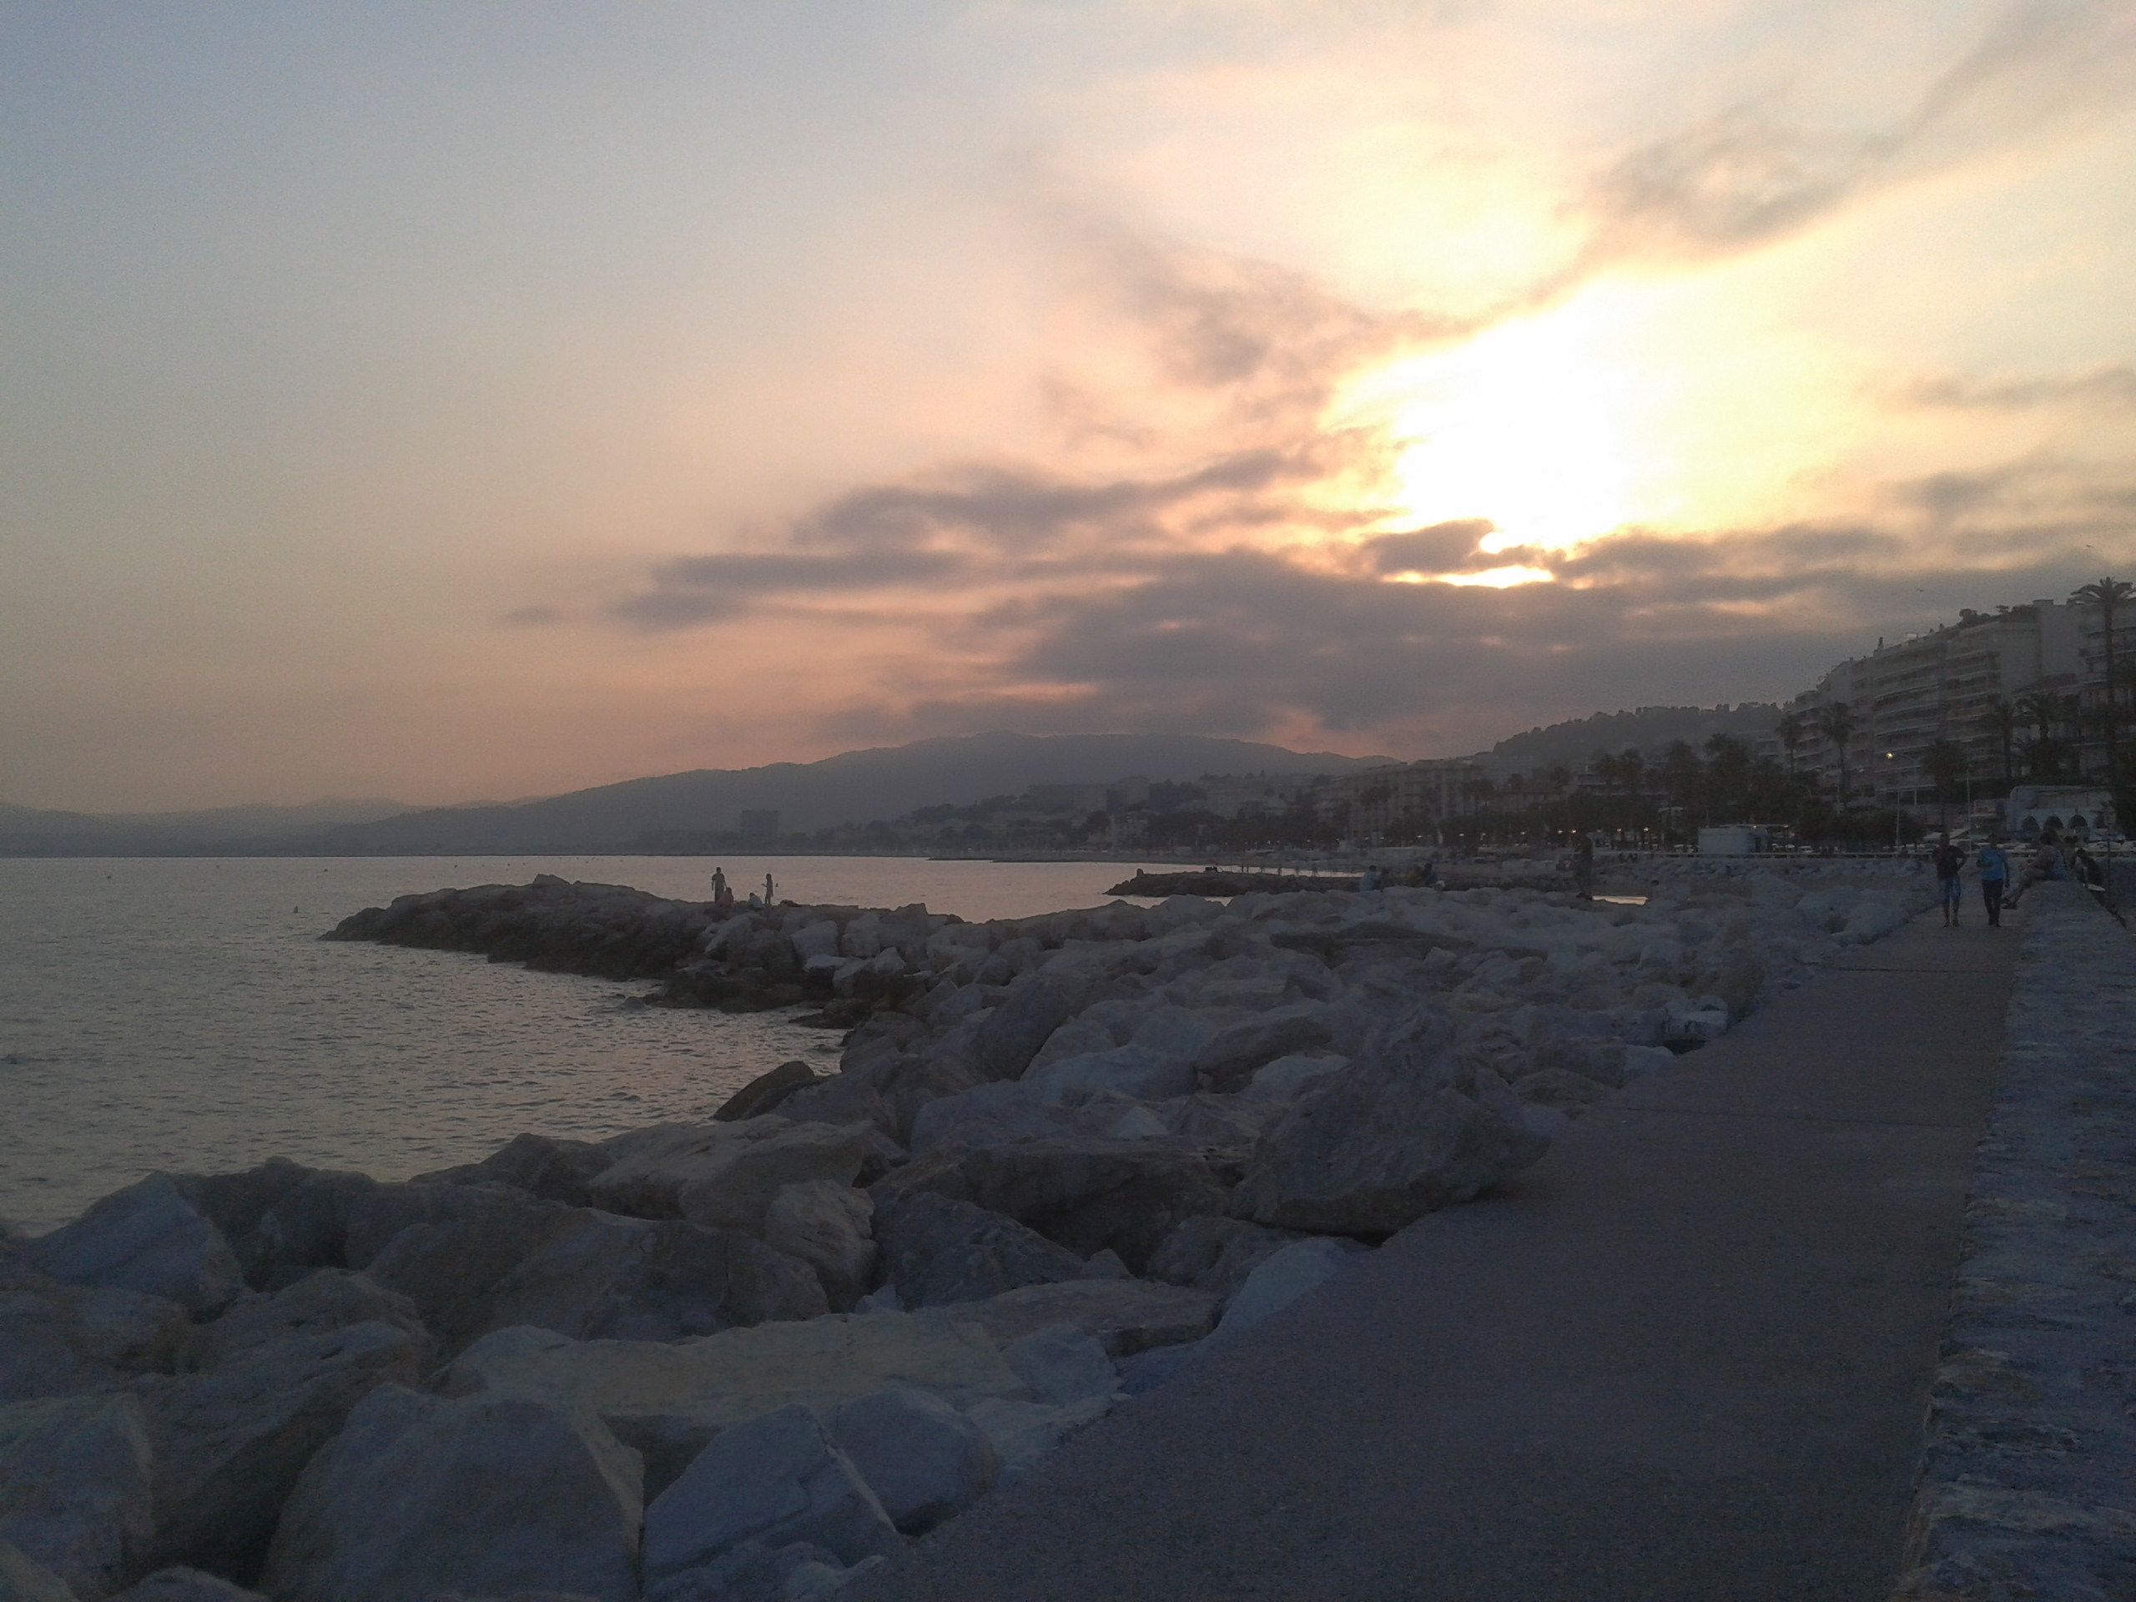
How about walking? We can take some photos!

Slide 11
To be honest some people give up really... early

Slide 12
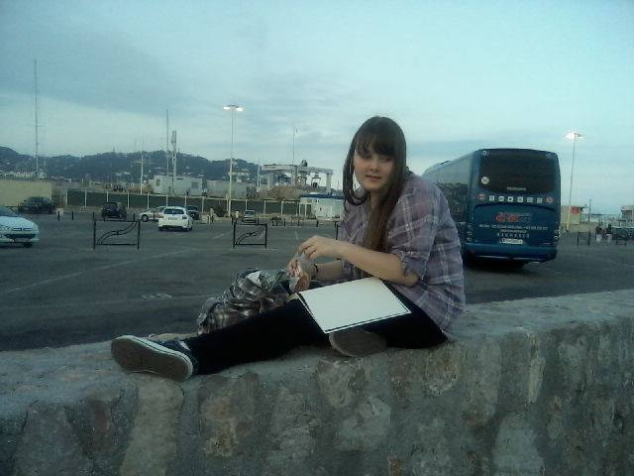
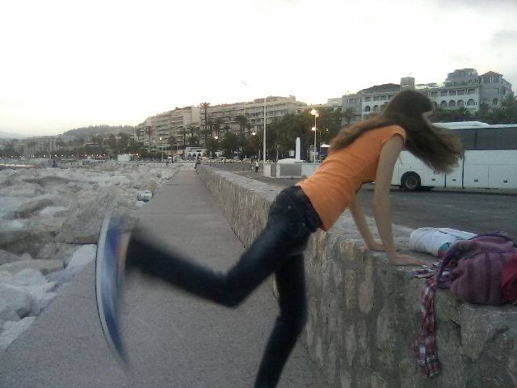
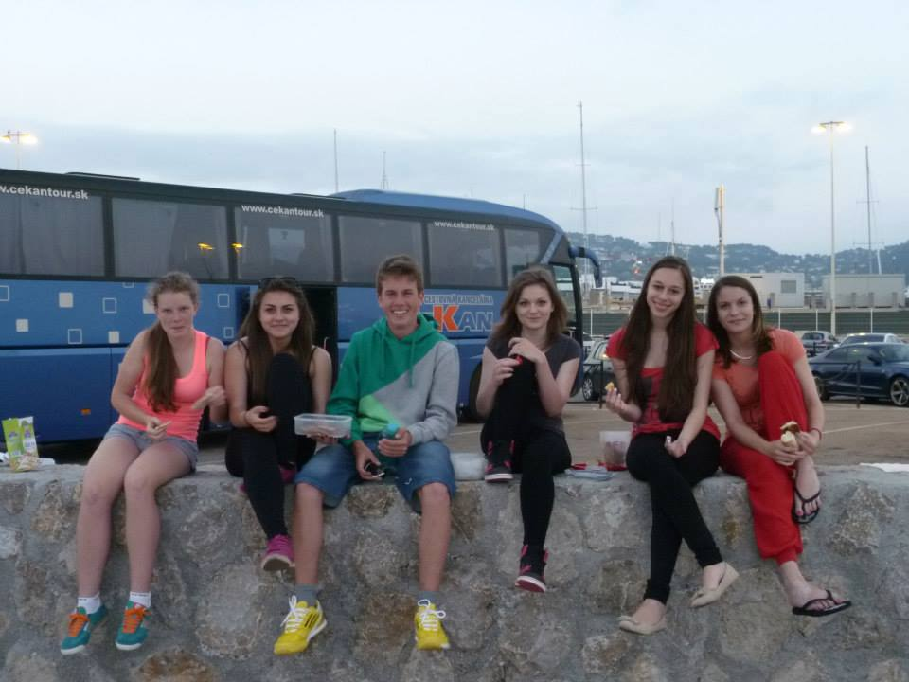
So... They mind their own business

Slide 13
However after “two“ tiring days we are finally in Spain! Actually We look like tired, hungry, dirty homeless people Neverthless We are still alive!

Slide 14
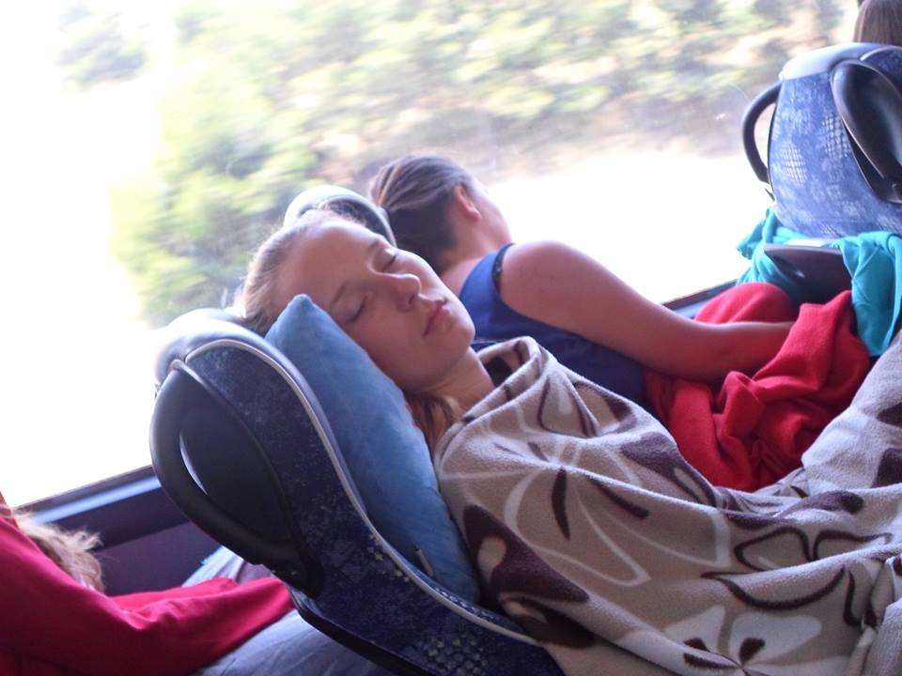
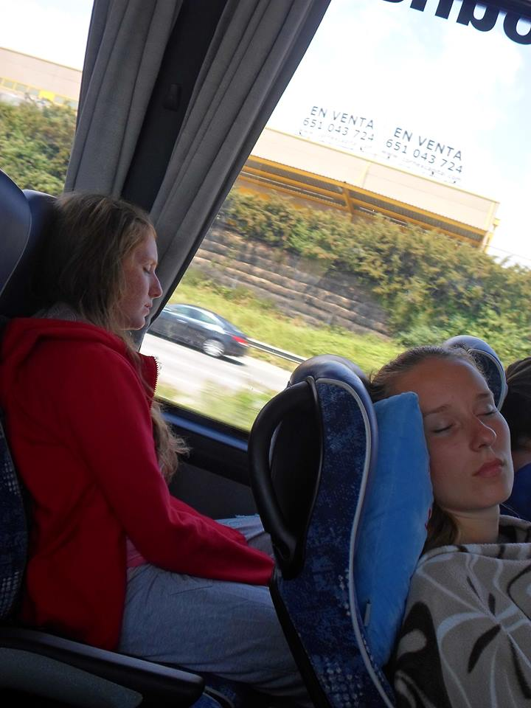
After 10 days there‘s again this terrible way back to Slovakia... *sighs* go go go! The same as before. for now next stop is in Italy

Slide 15
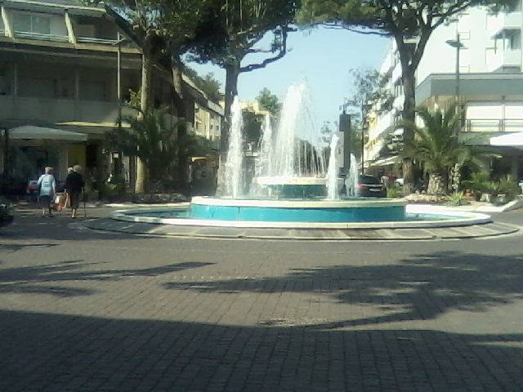
Almost the same as before. Photos. Sea. Food. Shopping. Givin‘ up. But there‘s a difference. It‘s hot and everything is expensive. EVEN things you would never expect that you can pay for. Yeah man.. This is Italy
Seriously. This is the only photo I have. It was nice fountain and roundabout..

Slide 16
On the other day ^^ Home sweet home! Eat and sleep well!

Slide 17
Thanks for your attention! Hope you liked it! ^^

